Slide 1
DiGiT recognizer
By
Arsalaan. D

Slide 2
Description
A Flask web app for handwritten digit recognition using a convolutional neural network.
It uses a MNIST (“Modified National Institute of Standards and Technology”) dataset with about 10 numeric digits. MNIST is the small dataset of computer vision.
The model was trained on this dataset in [Tensorflow] using [Keras API].

Slide 3
Features
Initial functional requirements will be: -
To recognize the digit.
Optical Character Recognition (OCR).

Slide 4
Platform & Hardware requirements
Platform:
OS: Linux/Unix, Windows 10, Windows 7, Mac OS X.
PL: Python, Flask, Keras.
Backend: Tensorflow.
Hardware Requirements:
Processor: Intel core i series & AMD Ryzen series or higher.
RAM: 4 GB or above.
Hard Disk: 10 GB or above.

Slide 5
Introduction to Python
Python is a widely used general-purpose, high level programming language. It was initially designed by "Van Rossum" in 1991 and developed by Python Software Foundation. It was mainly developed for emphasis on code readability, and its syntax allows programmers to express concepts in fewer lines of code.
Python language is one of the most flexible languages and can be used for various purposes.
Python has gained huge popularity base of this.

Slide 6
Why python for Machine Learnng
Python is considered to be in the first place in the list of all AI development languages due to the simplicity.
Python takes short development time in comparison to other languages like Java, C++ or Ruby.
Python supports object oriented, functional as well as procedure oriented styles of programming.
Python does contain special libraries for machine learning namely scipy and numpy which great for linear algebra and getting to know kernel methods of machine learning.

Slide 7
What is an AI (artificial intelligence)
AI (artificial intelligence) is the simulation of human intelligence processes by machines, especially computer systems.
These processes include learning (the acquisition of information and rules for using the information), reasoning (using the rules to reach approximate or definite conclusions) and self-correction.
Particular applications of AI include expert systems, speech recognition and computer vision.

Slide 8
Types of AI
Types of Artificial Intelligence Systems:
Machine Learning is where a computer system is fed large amounts of data, which it then uses to learn how to carry out a specific task, such as understanding speech or explaining a photograph.
Neural Networks are the key to process "Machine Learning". Researchers tried to reproduce the workings of the human brain by creating artificial networks of neurons and synapses.
Big Data is extremely large amount of data sets that may be analysed computationally to reveal patterns, trends, associations, especially relating to human behaviour and interactions.

Slide 9
neural Networks & thier types
Artificial neural networks are computational models which work similar to the functioning of a human nervous system. There are several kinds of artificial neural networks. These type of networks are as follows:
The Recurrent Neural Networks works on the principle of saving the output of a layer and feeding this back to the input to help in predicting the outcome of the layer.
Convolutional Neural Networks are similar to feed forward neural networks, where the neurons have learn-able weights and biases.
FeedForward Neural Network is one of the simplest form of ANN, where the data or the input travels in one direction. The data passes through the input nodes and exit on the output nodes. This neural network may or may not have the hidden layers. In simple words, it has a front propagated wave and no back propagation by using a classifying activation function usually.

Slide 10
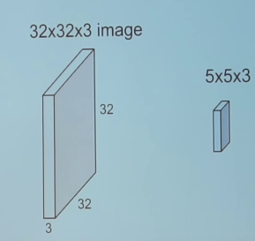
COnvolution Neural networks
CNNs have wide applications in image and video recognition and natural language processing. In this web app, use of CNNs is related to Computer Vision.
CNNs, like neural networks, are made up of neurons with learnable weights and biases.
Each neuron receives several inputs, takes a weighted sum over them, pass it through an activation function and responds with an output.
CNNs operates over volumes.
Unlike neural networks, where the input is a vector, here the input is a multi-channeled image.

Slide 11
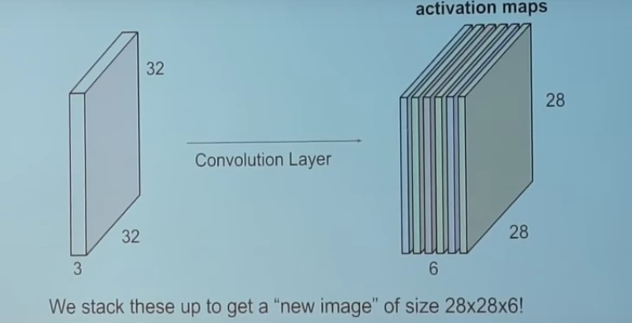
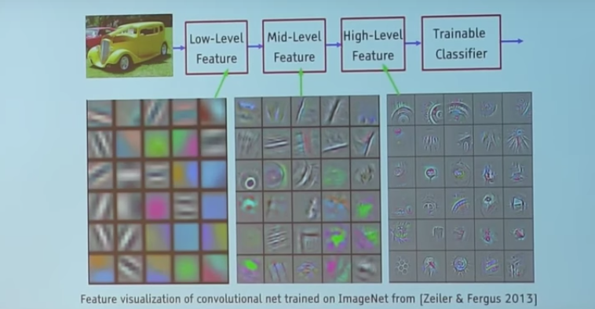
The convolution layer comprises of a set of independent filters (6 in the example shown). Each filter is independently convolved with the image and we end up with 6 feature maps of shape 28*28*1.
All these filters are initialized randomly and become our parameters which will be learned by the network subsequently.
All these filters or feature maps have some unique feature.

Slide 12
Then comes the Pooling Layer:
Its Its function is to progressively reduce the spatial size of the representation to reduce the amount of parameters and computation in the network. Pooling layer operates on each feature map independently.
The most common approach used in pooling is max pooling.

Slide 13
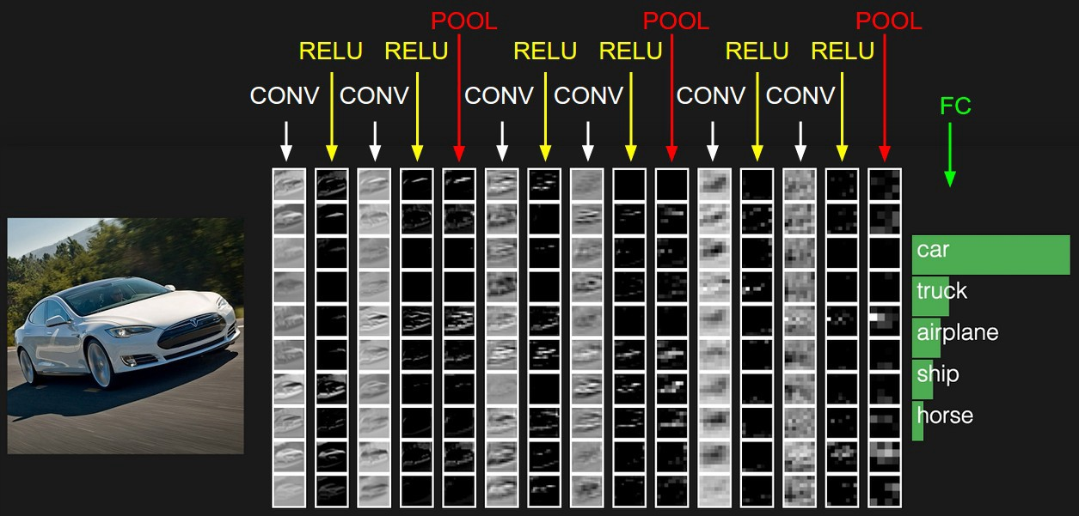
Typical architecture of CNN
RELU (Rectified Linear Unit) is just a non linearity which is applied similar to neural networks.
The FC is the fully connected layer of neurons at the end of CNN. Neurons in a fully connected layer have full connections to all activations in the previous layer.

Slide 14
Application
I have build a web application for handwritten digit recongnition, using 'Convoltional Neural Network'.
It has the capability to predict/detect any digit that a user draws.
It is wrapped into a Flask web app so you can access it from your browser.

Slide 15
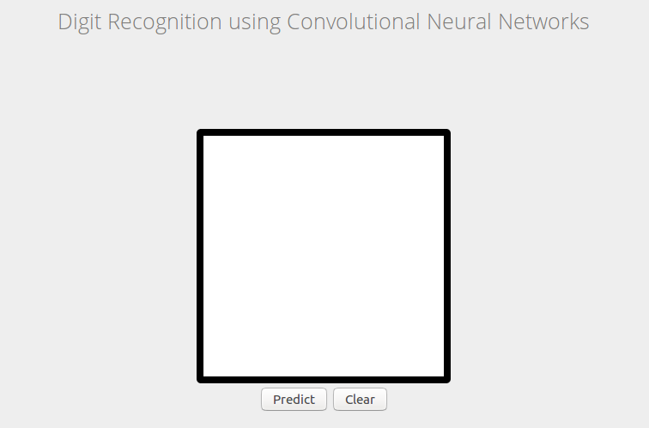
Input Area For User To Draw

Slide 16
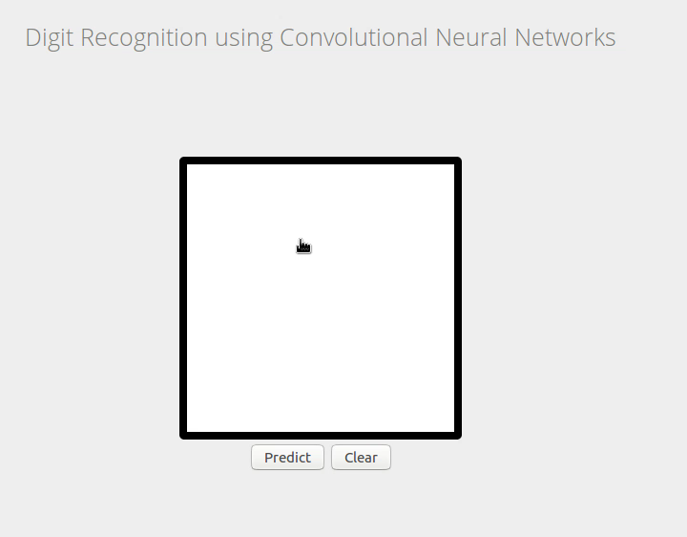
project demo

